Slide 1
Oop - Java static keyword final keyword
Lecture # 7

Slide 2
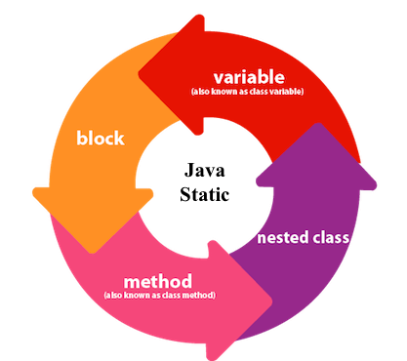
static Keyword
When a member in a Java program is declared/defined static, then it essentially means that the member is shared by all the instances of a class without making copies of per instance.
The keyword static means that the particular member belongs to a type itself, rather than to an instance of that type.
We can apply the keyword to;
Variable (also known as a class variable)
Method (also known as a class method)
Block
Nested class
When a member is declared static, then it can be accessed without using an object. This means that before a class is instantiated, the static member is active and accessible

Slide 3
Why Do We Need Static Variables And Where Are They Useful?
Static variables are most useful in applications that need counters.
The static variable can be used to refer to the common property of all objects (which is not unique for each object), for example, the company name of employees, college name of students, etc.
The static variable gets memory only once in the class area at the time of class loading.
Unlike non-static variables, such variables can be accessed directly in static and non-static methods.

Slide 4
Problem without static variable
Suppose there are 5000 students…
class Student{
int rollno;
String name;
String college="ITS";
}

Slide 5
Java Static Method
A static method belongs to the class, to invoke a static method, you don’t need a class object.
The static data members (variables) of the class are accessible to the static method. The static method can even change the values of the static data member.
A static method cannot have a reference to ‘this’ or ‘super’ members.
A static method can also call other static methods.
A static method cannot refer to non-static data members or variables and cannot call non-static methods too.

Slide 6
Restrictions for the static method
There are two main restrictions for the static method. They are:
The static method can not use non static data member or call non-static method directly.
this and super cannot be used in static context.
class A{
int a=40;//non static
public static void main(String args[]){
System.out.println(a);
} }

Slide 7
Overloading And Overriding Of Static Method
Example in the class…

Slide 8
The Math class in Java has almost all of its members static. So, we can access its members without creating instances of the Math class.
public class Main {
public static void main( String[] args ) {
// accessing the methods of the Math class System.out.println("Absolute value of -12 = " + Math.abs(-12));
System.out.println("Value of PI = " + Math.PI); System.out.println("Value of E = " + Math.E); System.out.println("2^2 = " + Math.pow(2,2));
} }

Slide 9
Static Block In Java
Is used to initialize the static data member.
It is executed before the main method at the time of classloading.
IMPORTANT: This static block is executed at the moment when the first object of the class is created (precisely at the time of classloading) or when the static member inside the block is used.
If you need to do the computation in order to initialize your static variables, you can declare a static block that gets executed exactly once, when the class is first loaded.

Slide 10
Multiple Static blocks
They execute in the given order which means the first static block executes before second static block.

Slide 11
Characteristics of static keyword:
Shared memory allocation
Accessible without object instantiation
Associated with class, not objects
Cannot access non-static members
Can be overloaded, but not overridden

Slide 12
Static and dynamic binding in java

Slide 13
Static vs Dynamic Binding
Association of method call to the method body is known as binding.
There are two types of binding: Static Binding that happens at compile time and Dynamic Binding that happens at runtime.

Slide 14
What is reference and object?
class Human{
....
}
class Boy extends Human{
public static void main( String args[]) {
/*This statement simply creates an object of class *Boy and assigns a reference of Boy to it*/
Boy obj1 = new Boy();
/* Since Boy extends Human class. The object creation can be done in this way. Parent class reference can have child class reference assigned to it
*/
Human obj2 = new Boy();
}
}

Slide 15
Static vs Dynamic Binding
When the method overriding is actually happening and the reference of parent type is assigned to the object of child class type then such binding is resolved during runtime.
The binding of overloaded methods is static and the binding of overridden methods is dynamic.

Slide 16
Static Binding or Early Binding
The binding which can be resolved at compile time by compiler is known as static or early binding.
The binding of static, private and final methods is compile-time. Why?
The reason is that the these method cannot be overridden and the type of the class is determined at the compile time.
Example in the class…

Slide 17
Dynamic Binding or Late Binding
When compiler is not able to resolve the call/binding at compile time, such binding is known as Dynamic or late Binding.
Method Overriding is a perfect example of dynamic binding as in overriding both parent and child classes have same method and in this case the type of the object determines which method is to be executed.
The type of object is determined at the run time so this is known as dynamic binding.

Slide 18
Place holders in Strings
System.out.printf("Current country: %s \n", country);

Slide 19
Final keyword

Slide 20
final variable final method final class

Slide 21
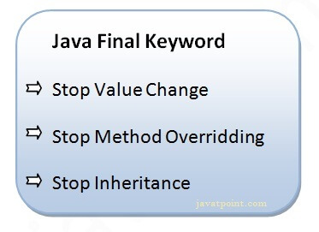
Final variables
final variables are nothing but constants. We cannot change the value of a final variable once it is initialized.
Final Methods cannot be overridden
Final Classes cannot be inherited

